Slide 1
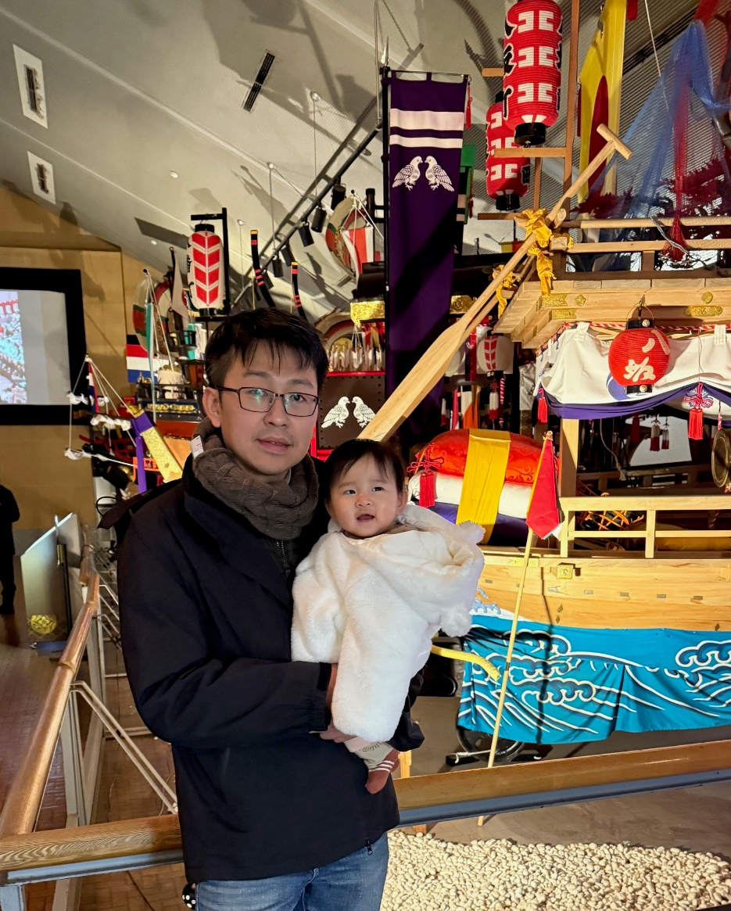
About Me : 黃彥穎
Experience
Senior manager of M31 Technology
Technical Manager of Richtek Technology
R&D of Faraday Technology
Education
B.S. and M.S. in EE, National Chiao Tung University (NCTU)
Interest and Study
Architecture & System defined
USB PD system
LPDDR, Displayport
Ultrasonic system
Algorithm development
Ultrasonic beamforming
Time of flight system
Doppler flow estimation
Clocking related
PLL, DLL, CDR, TDC
All digital Clocking : ADPLL, ADDLL, SSCG…

Slide 2
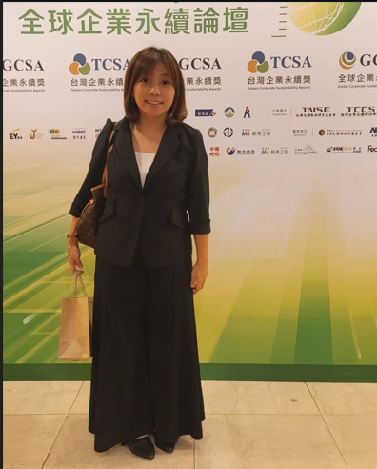
About Me : 黃淑貞 Jenny Huang
Experience (20 years of erperience in HR)
HR manager of M31 Technology 2021~Now
Deputy Manager of Focaltech
Senior Specialist of Fitipower
Education
M.S. in HRM, National Sun Yat-sen University University (NSYSYU)
Interest and Study
Recruitment & Talent Acquisition
Training & Development
Workforce Planning & Analytics
IDP (Individual Development Plan)
ESG

